Slide 1
SMARTBRIDGE INTERNSHIP
Smart Sorting
Transfer learning for identifying rotten fruits
Team members:
Syamala Sai Kiran Reddy
Tammana Rithika Dhana Varshini
Potla Ravi Teja
Reddy Sudha Sree

Slide 2

Abstract
This project focuses on using transfer learning techniques to accurately identify rotten fruits and vegetables, enhancing sorting efficiency in the agricultural sector.
Transfer Learning
Identification Process
Impact on Industry
Utilizes pre-trained models to improve accuracy in recognizing rotten produce, saving time and resources.
Incorporates advanced algorithms for real-time detection, ensuring quality control in food supply chains.
Aims to reduce waste and improve sustainability, benefiting both consumers and producers in the agricultural market.

Slide 3
Smart Sorting
Smart Sorting utilizes advanced transfer learning techniques to accurately identify rotten fruits and vegetables, enhancing food quality and reducing waste effectively.
Transfer Learning
Machine Learning
Waste Reduction
Transfer learning leverages existing models to recognize specific features in new tasks, improving identification accuracy and efficiency.
Machine learning algorithms analyze large datasets to learn patterns, enabling automated recognition of rotten produce.
Implementing smart sorting can significantly lower food waste levels, contributing to sustainable practices in agriculture and consumption.

Slide 4
Problem Statement
The issue of identifying rotten fruits and vegetables affects both consumers and retailers, leading to economic losses and health concerns.
Detection Techniques
Technology Integration
Consumer Awareness
Various methods are used for detecting spoilage, including visual inspection and chemical analysis.
Implementing machine learning and AI can enhance detection efficiency and accuracy in identifying rotten produce.
Raising awareness about the importance of freshness can lead to better purchasing decisions and reduced waste.

Slide 5
Requirements
The project requires advanced technology for identifying rotten fruits and vegetables, integrating machine learning and image processing techniques to enhance accuracy.
Machine Learning
Image Processing
Sensors
Utilizes algorithms for analyzing data to classify fruits and vegetables effectively.
Involves techniques to enhance visual features for better detection of spoilage.
Employs various sensors to collect real-time data on fruit and vegetable conditions.

Slide 6
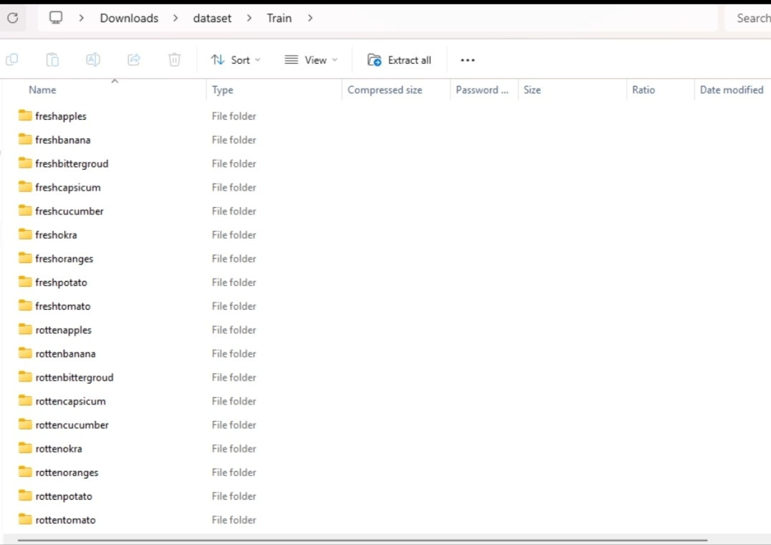
Dataset

Slide 7
Project Design
The design incorporates advanced algorithms for identifying rotten produce, enabling efficient sorting for better quality control in the food supply chain.
Algorithm Development
Data Collection
User Interface
Utilizes transfer learning for enhanced accuracy in recognizing rotten fruits and vegetables.
Gathers diverse and extensive datasets to train models effectively, ensuring robust performance across various conditions.
Features a simple, intuitive interface for easy operation and real-time feedback.

Slide 8
Model Selection and Performance
Model
DenseNet121
MobileNetV2
ResNet-50
Xception
Efficient NetB7
Accuracy
93.3
93.0
92
92.5
87

Slide 9
Pros and Cons
This section analyzes the advantages and disadvantages of using smart sorting technology for identifying rotten fruits and vegetables.
Advantage 1
Advantage 2
Disadvantage 1
Increased efficiency in sorting reduces waste significantly.
Cost-effective solution for farmers, leading to higher profits.
Initial setup costs can be high for small farms.

Slide 10
Conclusion
The project demonstrates the effectiveness of transfer learning in identifying rotten fruits and vegetables, paving the way for smarter sorting solutions in agriculture.
Future Implications
Technological Advancement
Sustainability Focus
This technology can enhance food safety and reduce waste through more efficient sorting mechanisms.
Utilizing AI and machine learning, we are advancing the capabilities of agricultural practices with improved accuracy.
This project contributes to a sustainable future by minimizing food waste and promoting healthier consumption habits.

Slide 11
Future Scope
The future of Smart Sorting involves enhancing accuracy, expanding to other produce types, and integrating AI for better results.
Enhanced Accuracy
Broader Applications
AI Integration
Using advanced algorithms for precise detection of spoilage and quality.
Adapting the technology for various fruits, vegetables, and other perishable goods.
Incorporating machine learning to continuously improve sorting processes and outcomes.

Slide 12
Thank You!

